Slide 1

DATA ANALYSIS
Food Delivery Company
A data-driven look at how orders move from restaurant to doorstep
Team Members: Project Supervisor:
Alaa Mohamed Fekry
Malak Emad Kamal
Amira Mohamed Ismail
Mohamed Ehab Mahmoud
Maryam Ramadan Ahmed
Esraa Eleraky

Slide 2



Project Overview
Food delivery is a courier service in which a restaurant, store, or independent food-delivery company delivers food to a customer. Orders are typically placed through a restaurant or grocer's website or mobile app, or through a food ordering platform.
Order Placed
App or website
Prepared
Restaurant or store
Delivered items can include entrées, sides, drinks, desserts, or grocery items, typically packaged in boxes or bags. Couriers usually drive a car, though in denser cities — where restaurants and homes sit closer together — bikes or motorized scooters are common.
Packaged
Boxes or bags
Delivered
Car, bike, or scooter

Slide 3
SECTION 01
Data Cleaning using python
Preparing the raw delivery dataset in Python (pandas) for analysis

Slide 4
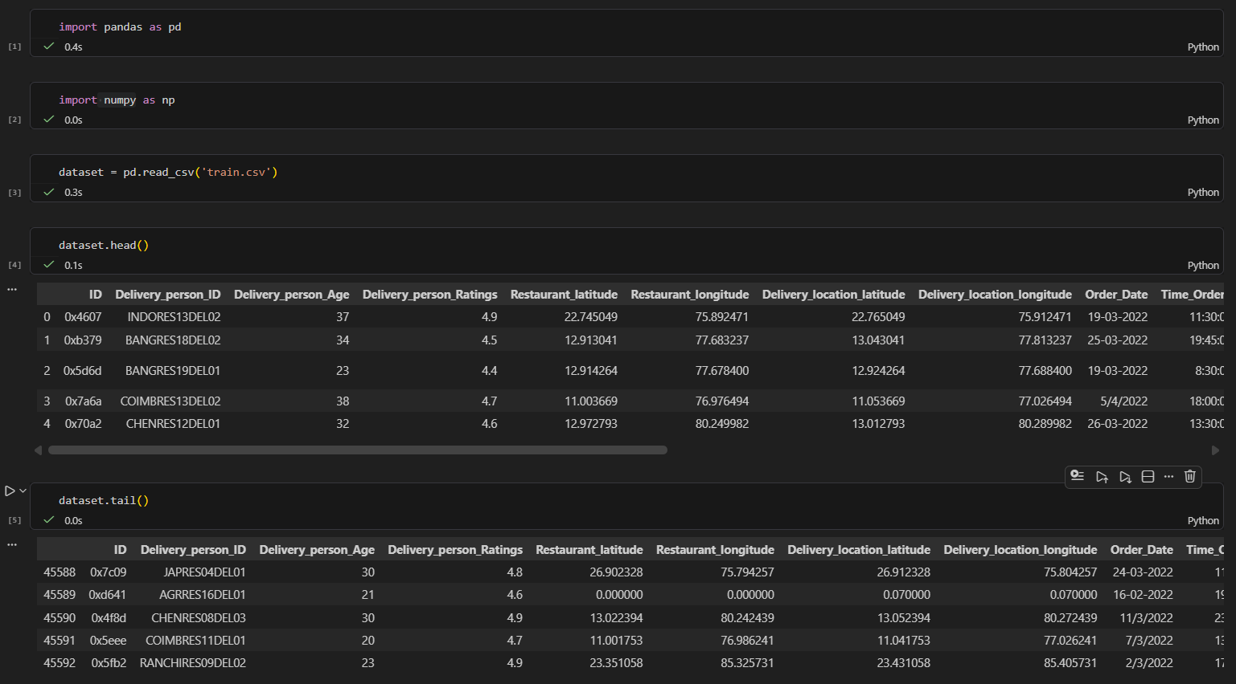
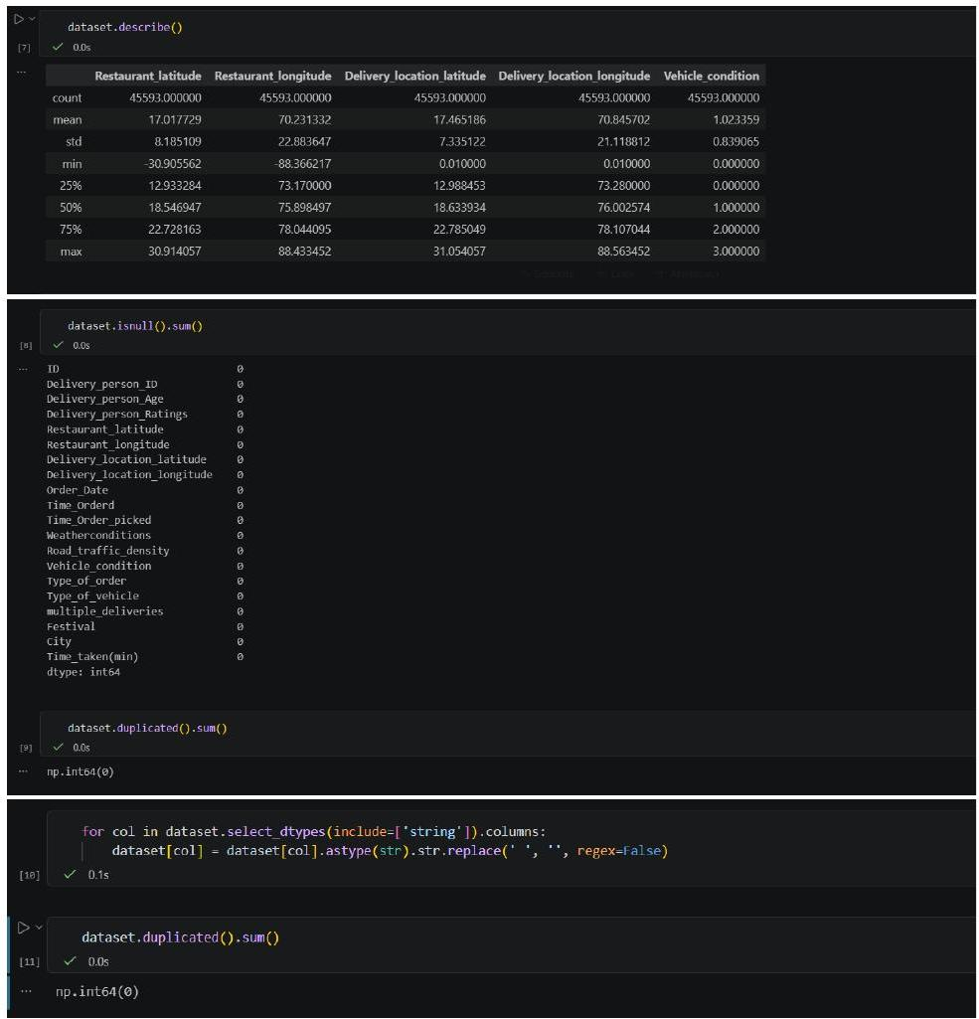
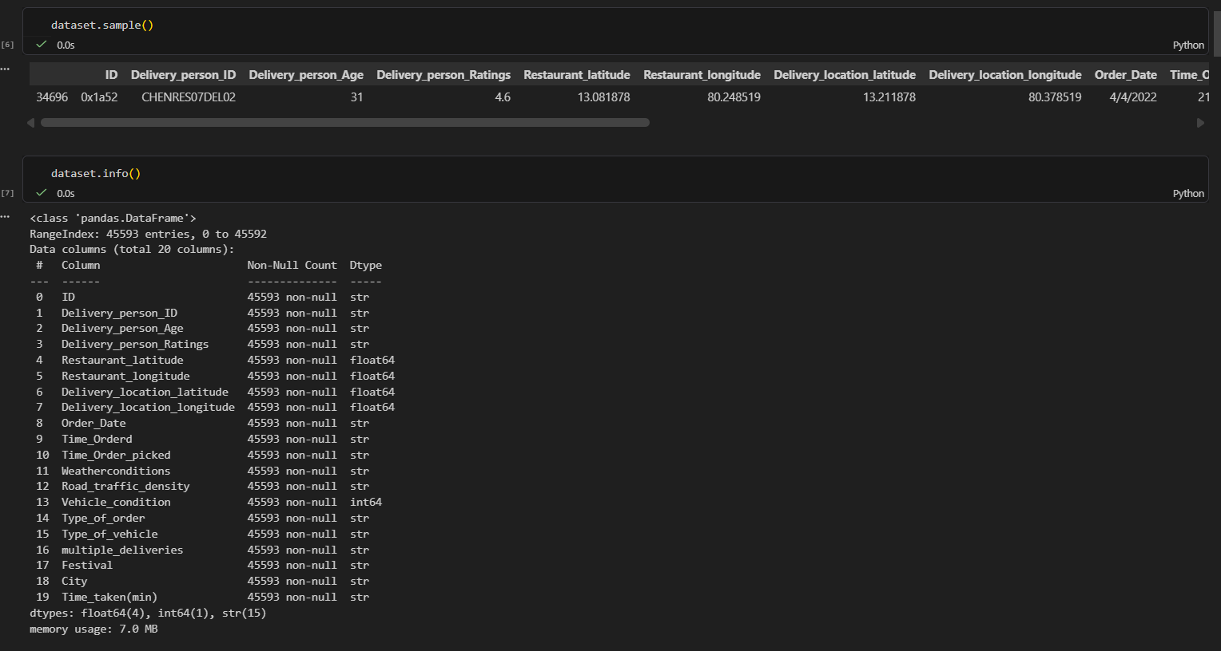

Slide 5
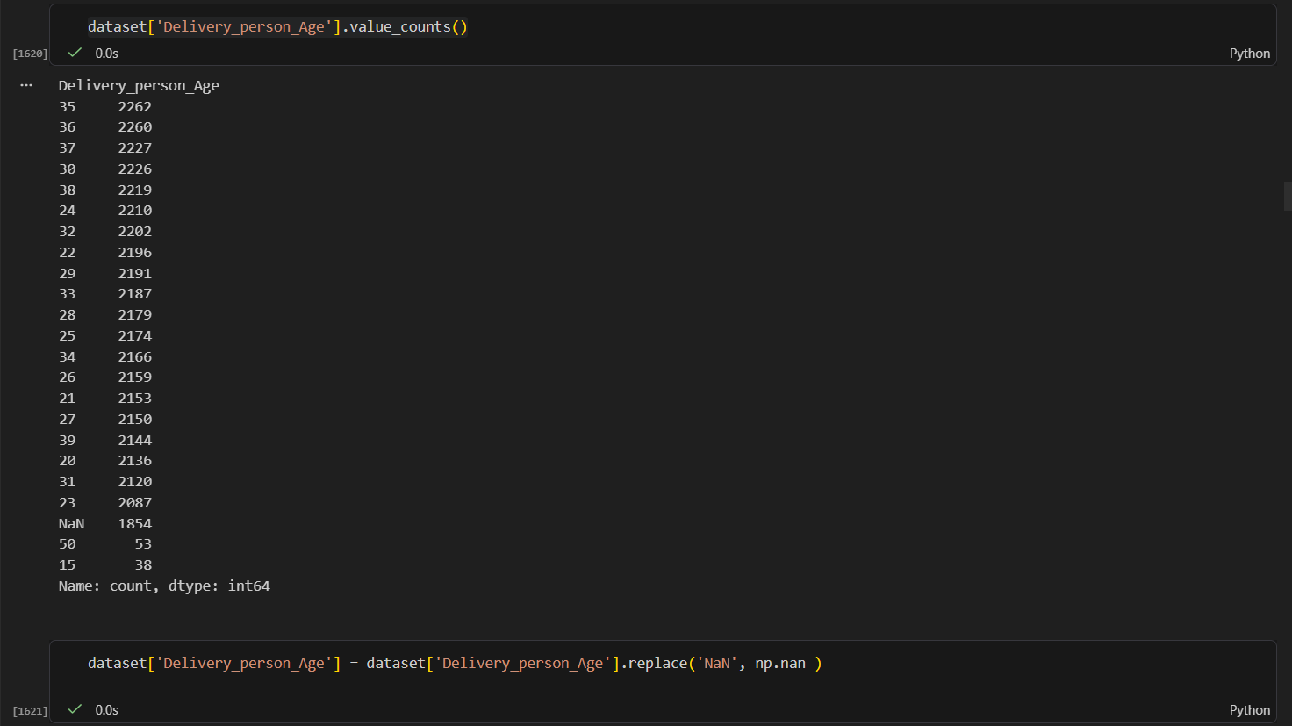
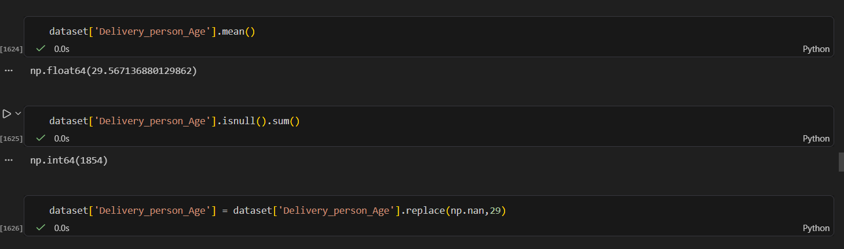
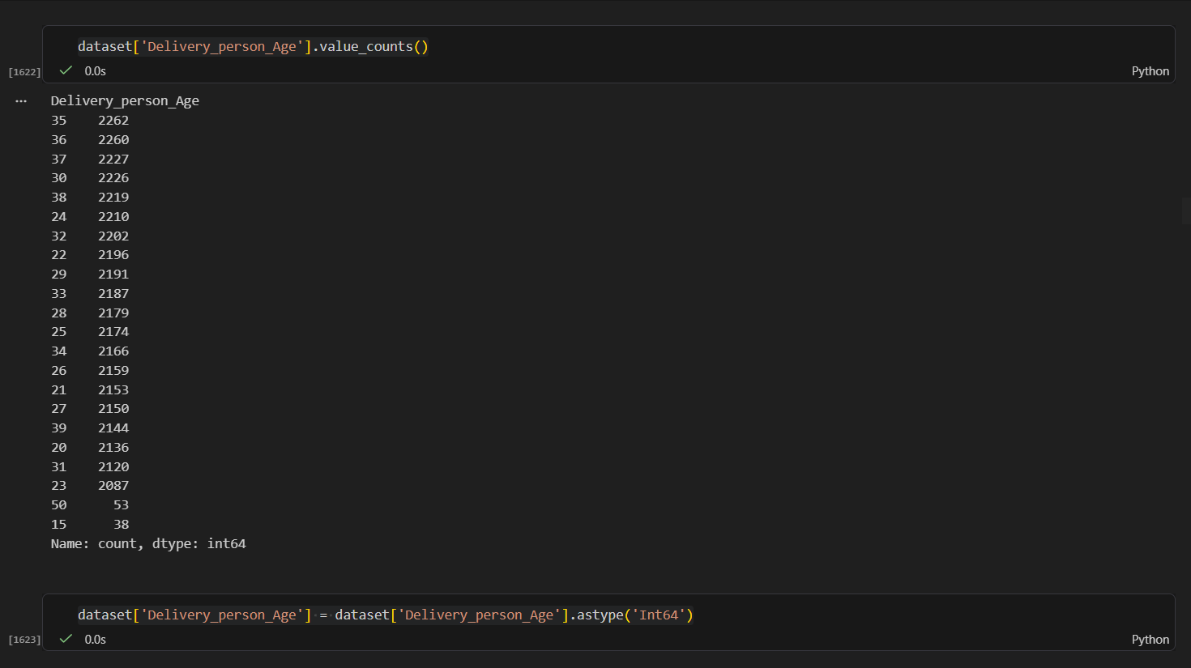
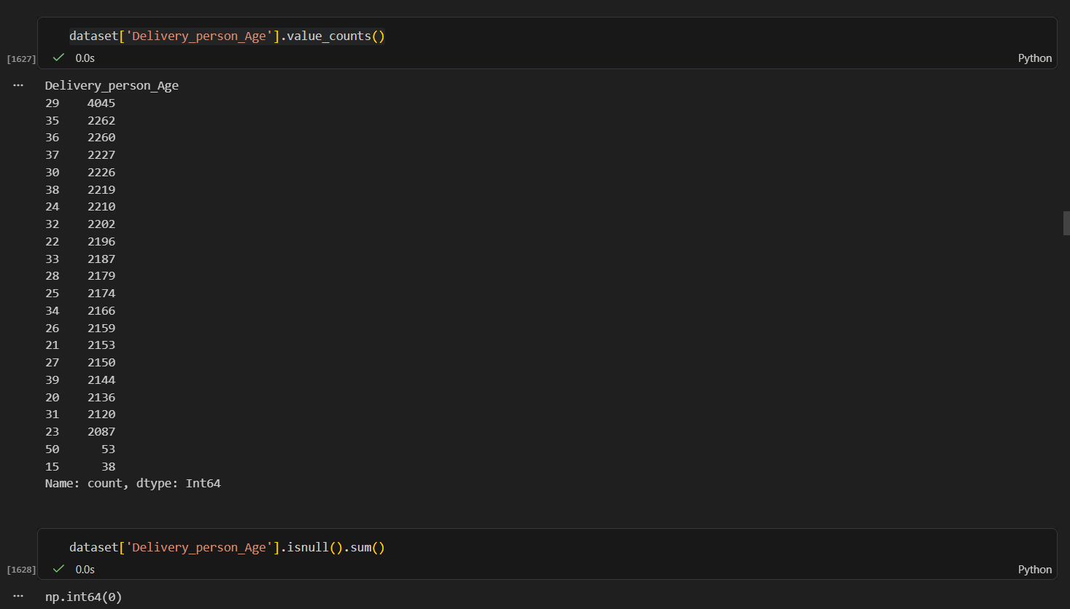
Fixing Ages

Slide 6
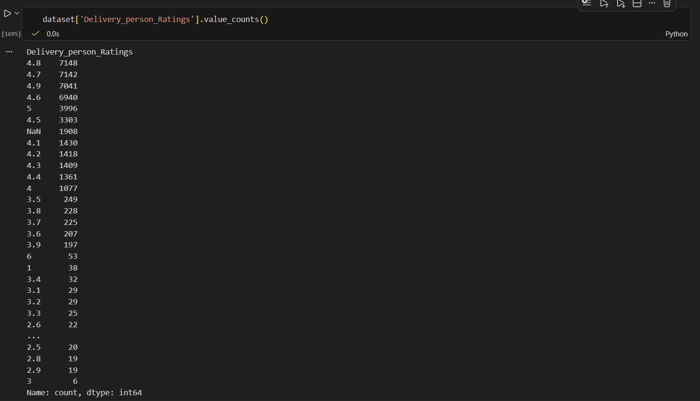
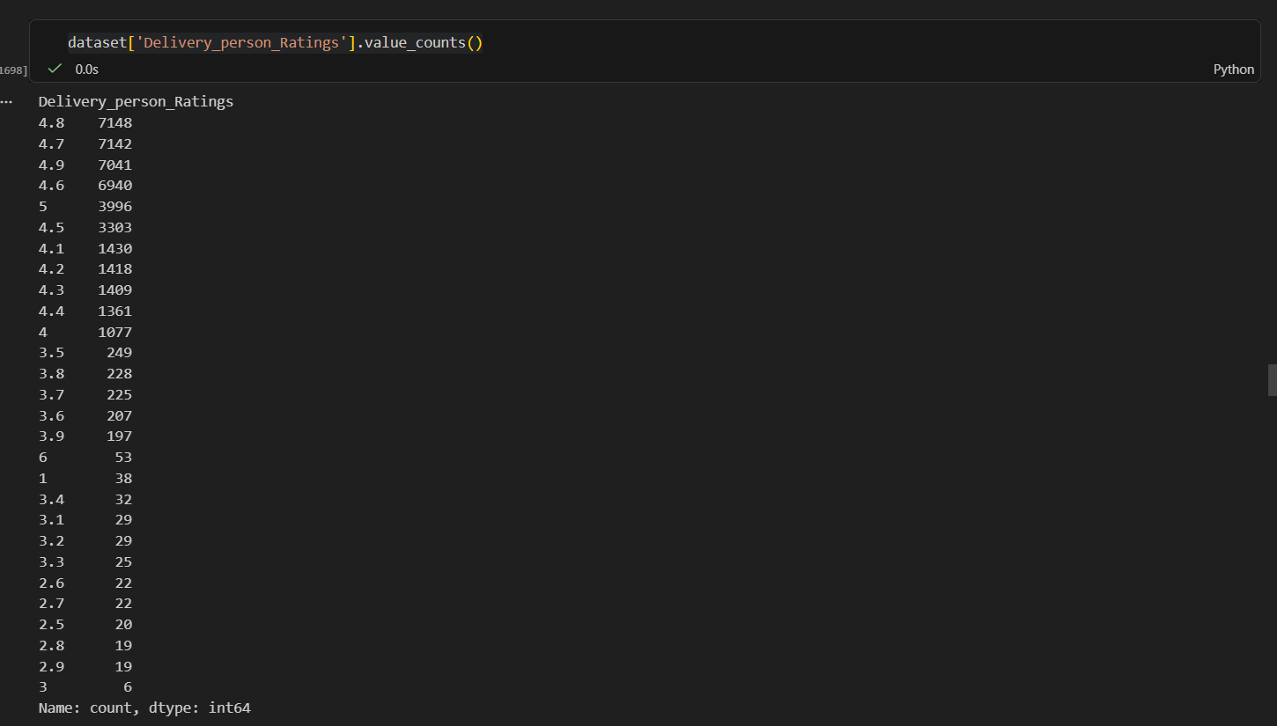

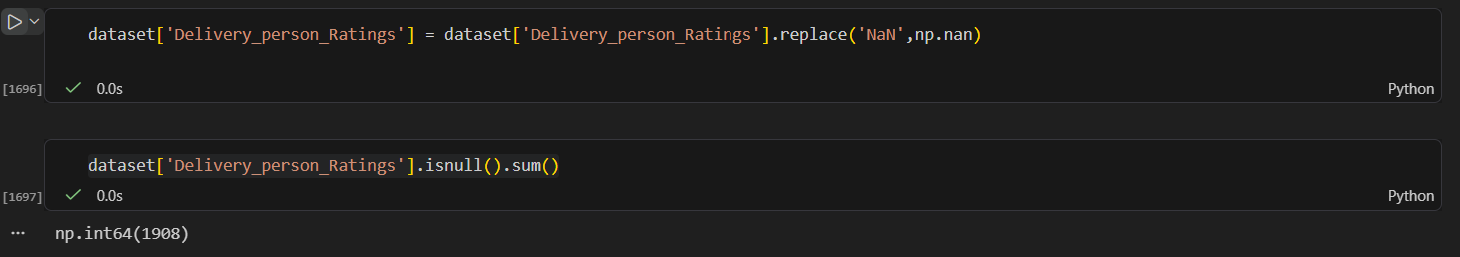
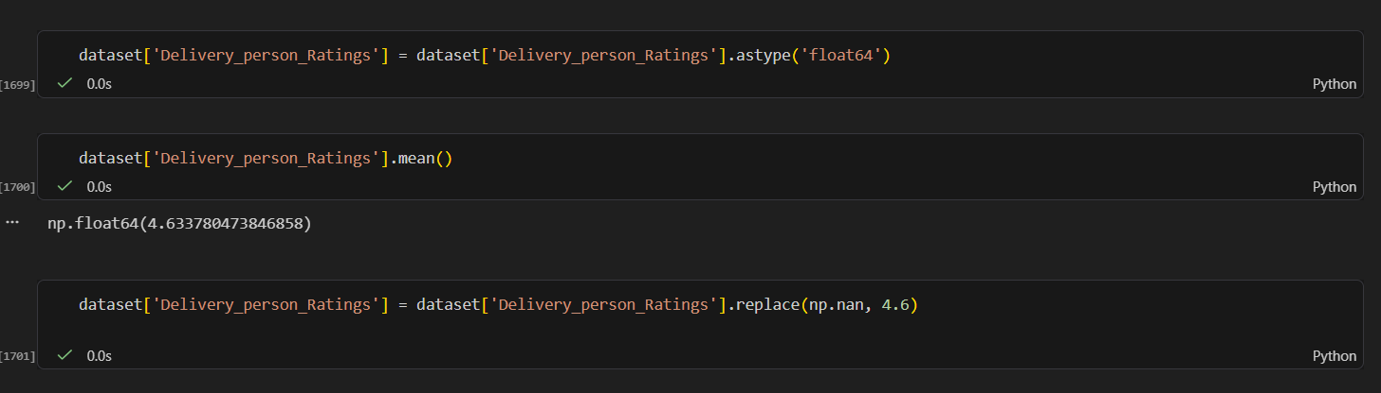

Slide 7
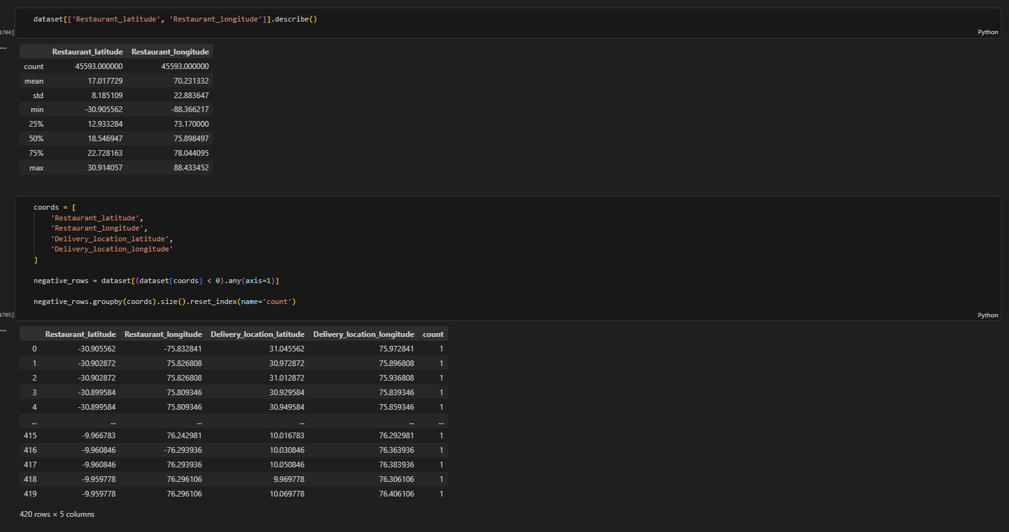
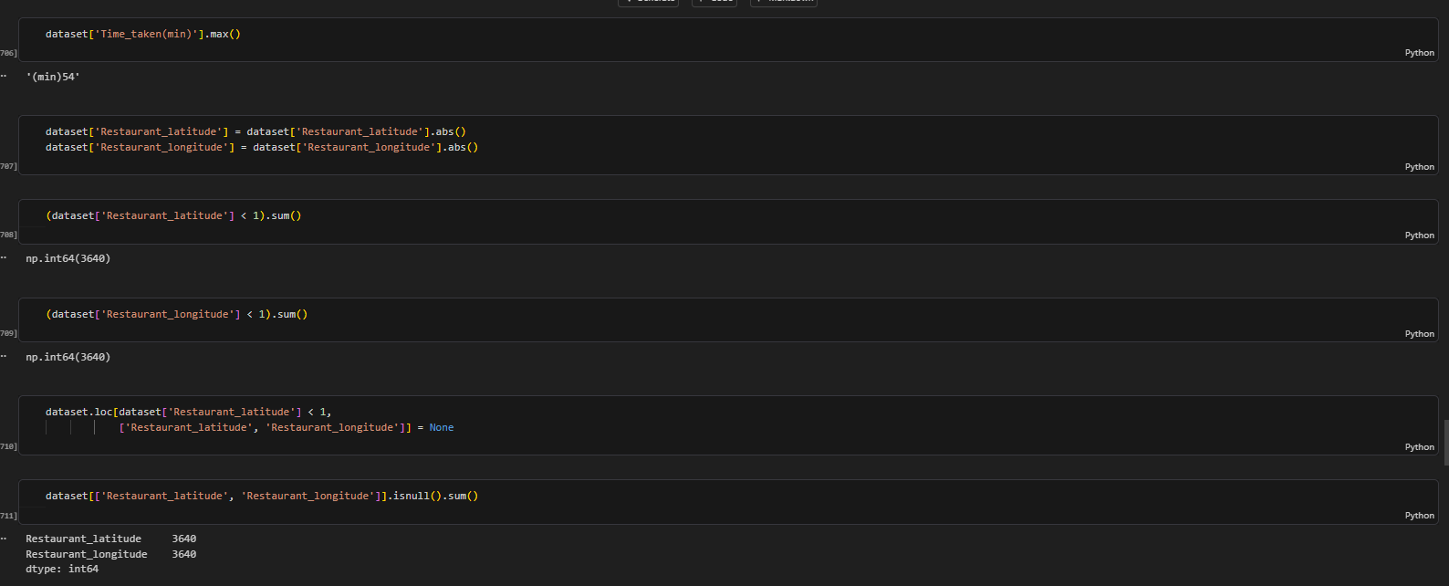

Slide 8
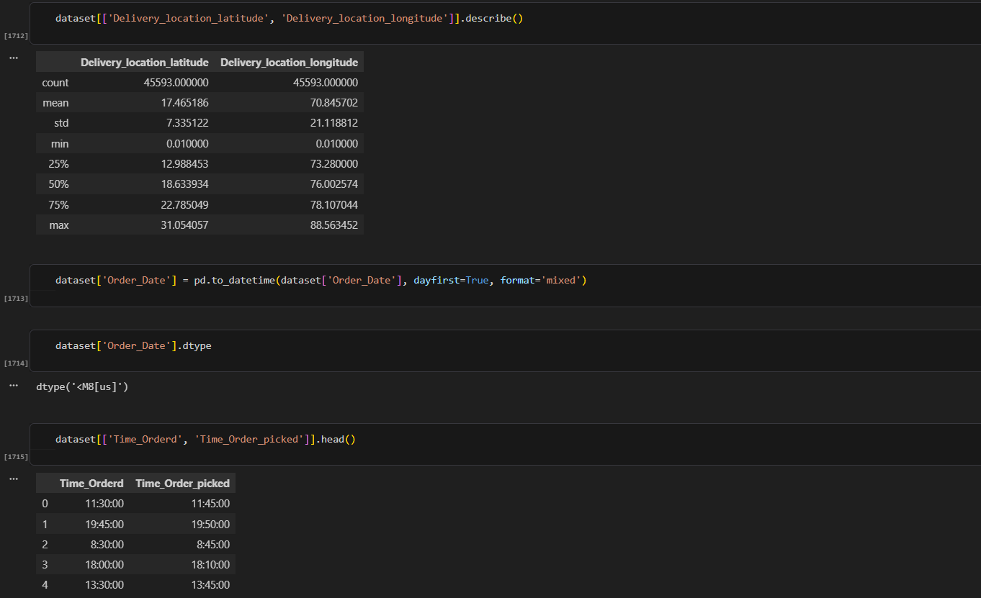
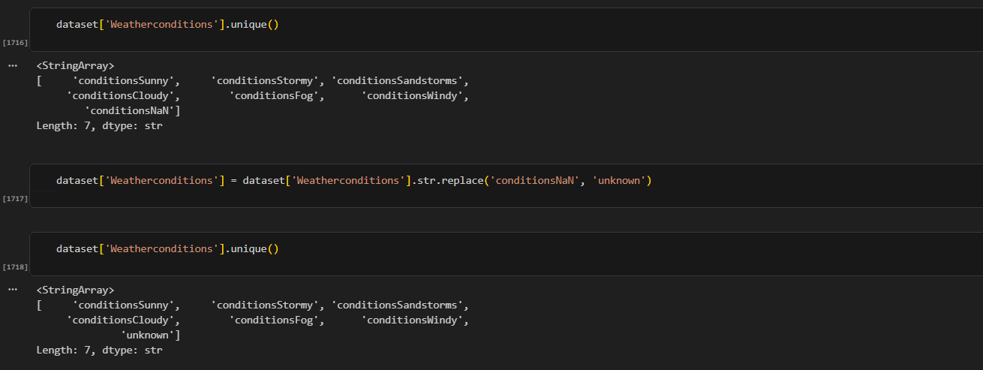
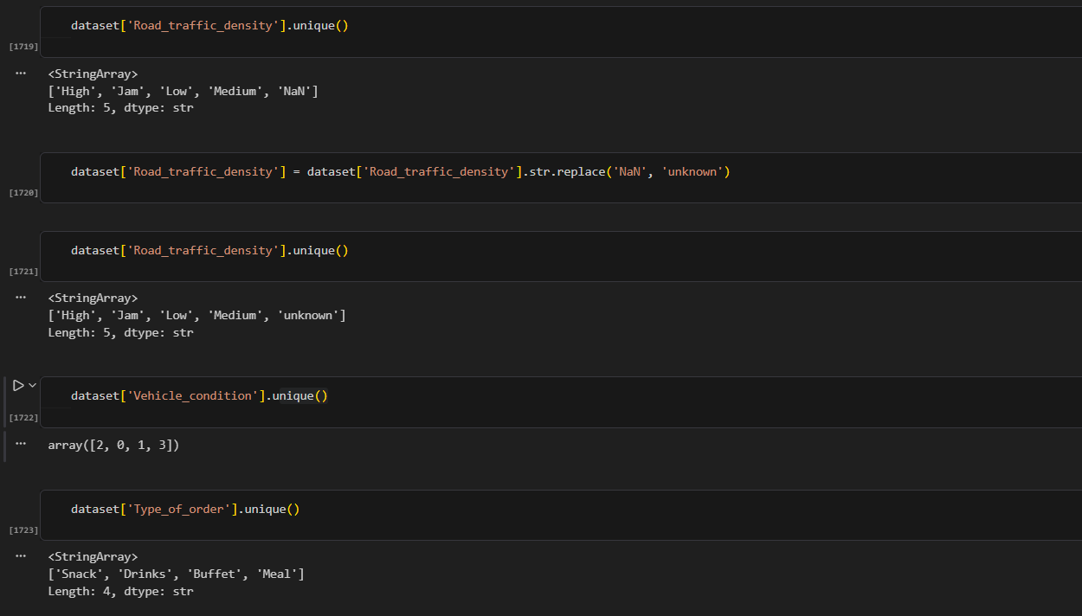

Slide 9
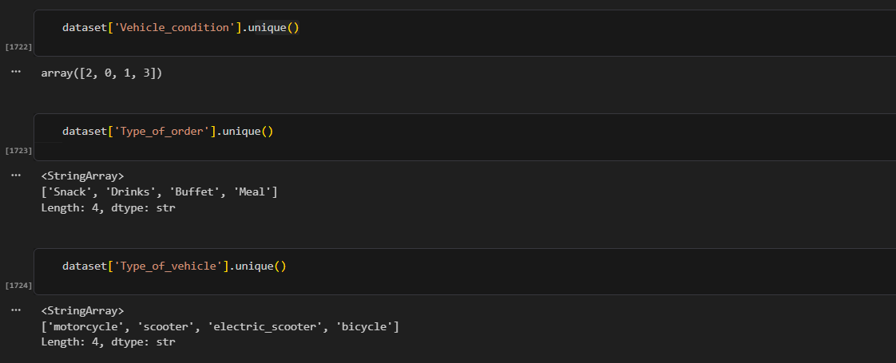
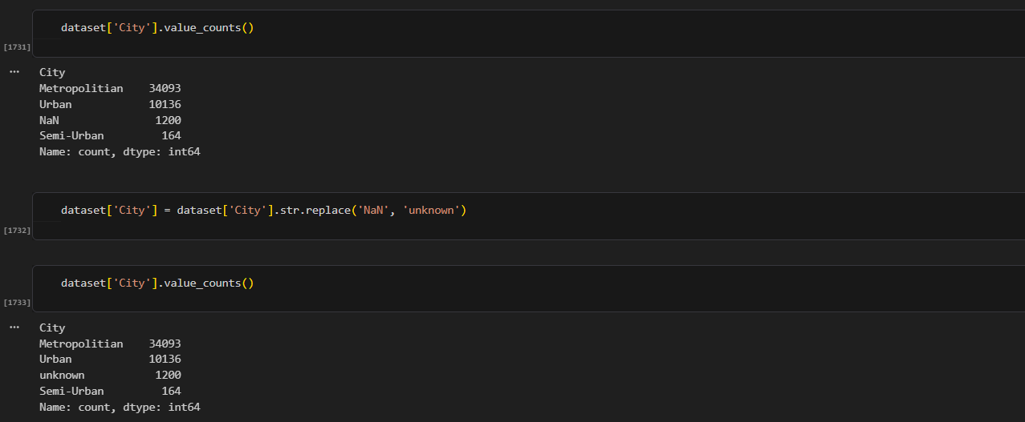
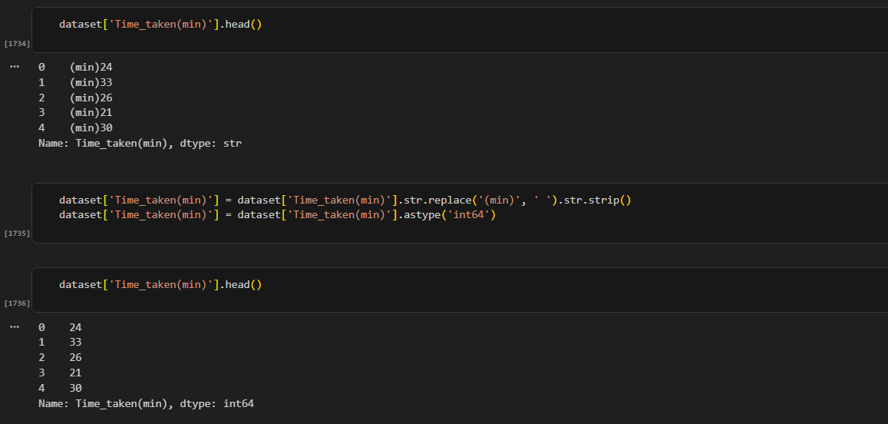
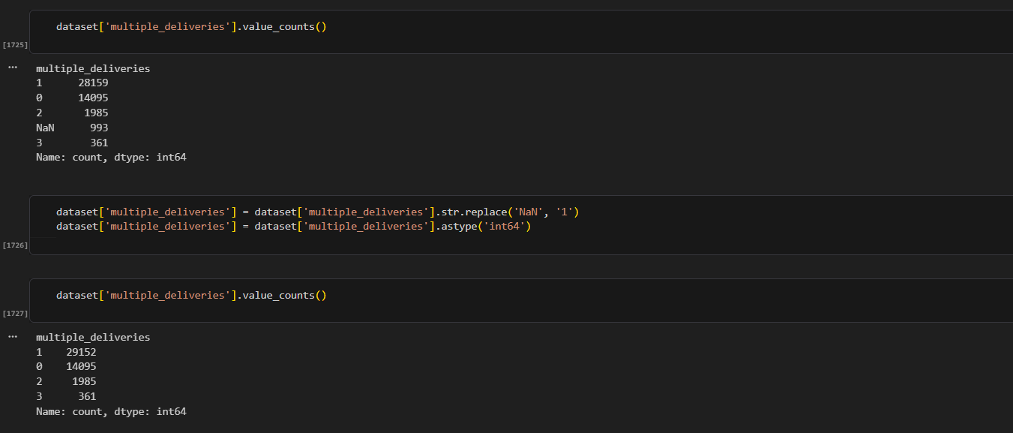
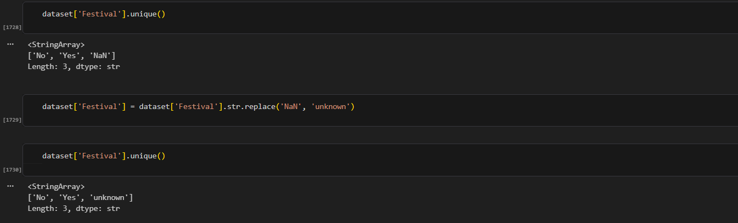

Slide 10
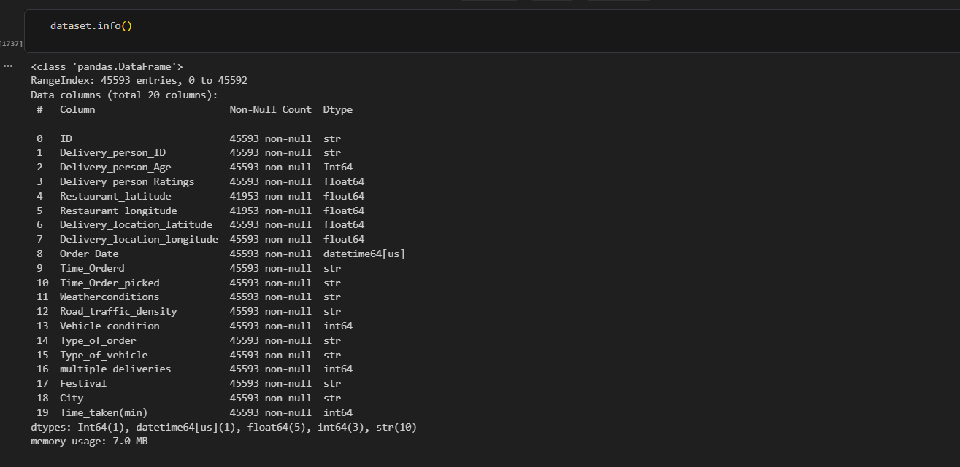
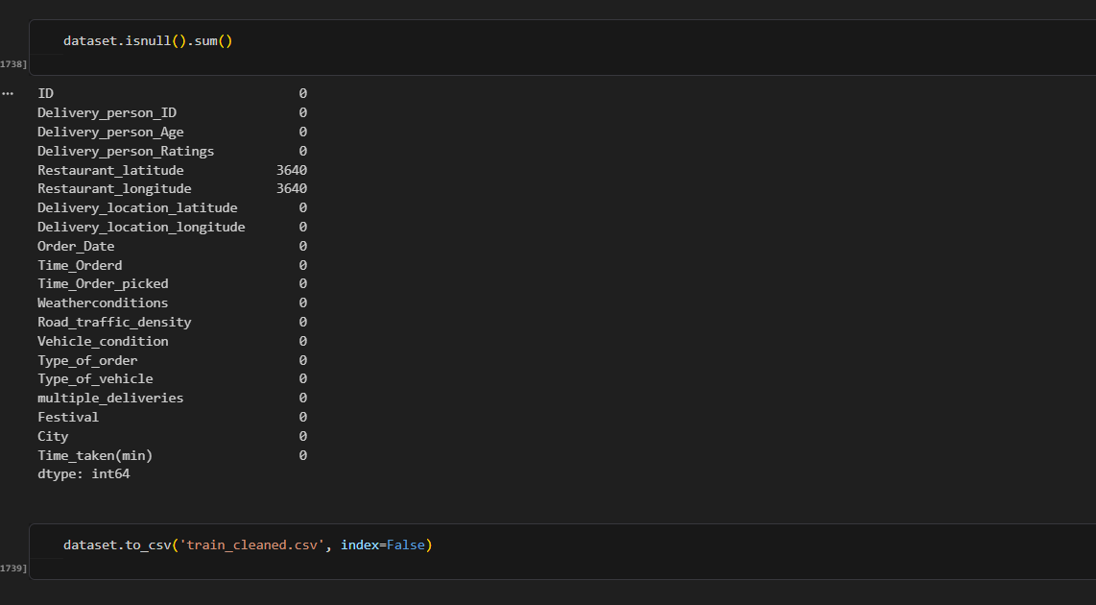

Slide 11
SECTION 02
Data Analysis using SQL
Querying the cleaned dataset to uncover delivery performance patterns

Slide 12
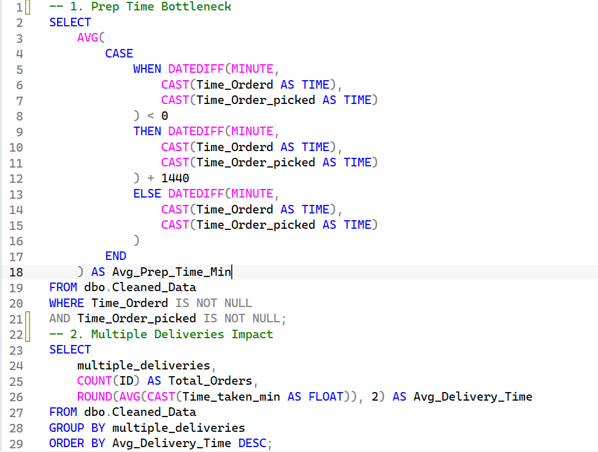
PART 1 · QUERY ANALYSIS
Prep Time & Multiple Deliveries
Insight: Average preparation time is around 9 minutes, indicating that restaurant preparation contributes to the overall delivery time.
Recommendation: Improve restaurant preparation speed with standard prep-time targets and optimize rider assignment timing to cut waiting time.
Insight: Orders with multiple deliveries show higher average delivery times, indicating that combining orders may increase delays.
Recommendation: Cap the number of orders assigned to one rider, and only combine deliveries that fall along the same geographic route.

Slide 13
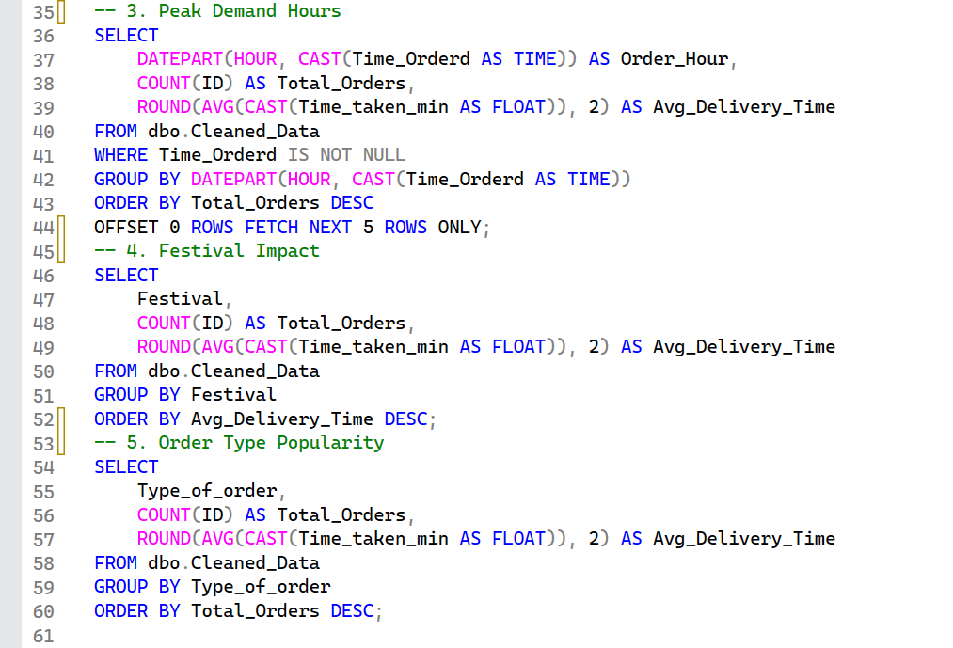
PART 1 · QUERY ANALYSIS
Peak Hours, Festivals & Order Type
Insight: The highest order volume occurs during evening peak hours (7 PM–11 PM), increasing delivery pressure and rider demand.
Recommendation: Increase rider availability during peak hours and offer promotions in low-demand periods to balance order volume.
Insight: Orders during festival periods have a higher average delivery time (45.52 min), showing festivals raise pressure and congestion.
Recommendation: Prepare additional riders during festival periods and adjust ETAs to reflect high-congestion conditions.
Insight: Snack orders have the highest volume, closely followed by Meal and Drinks orders — demand is fairly similar across types.
Recommendation: Create offers and menus around the most popular categories, and work with restaurants to keep them well stocked.

Slide 14
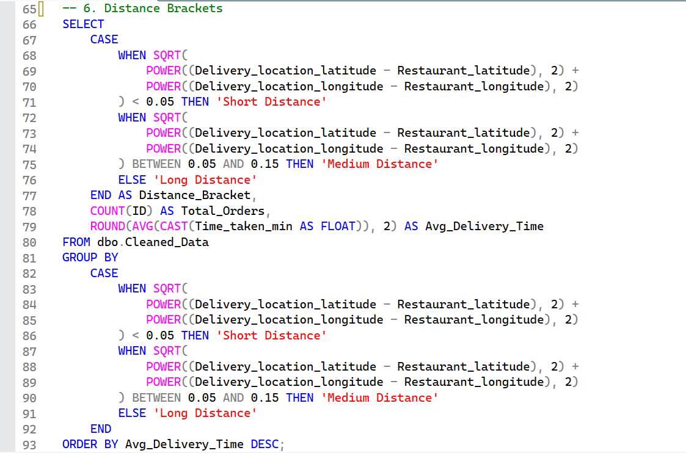
PART 1 · QUERY ANALYSIS
Distance Brackets
Insight: Long-distance orders have the highest average delivery time (28.69 min), showing distance negatively affects delivery efficiency.
Recommendation: Increase delivery fees as distance grows, and prioritize nearby orders to improve overall delivery speed.

Slide 15
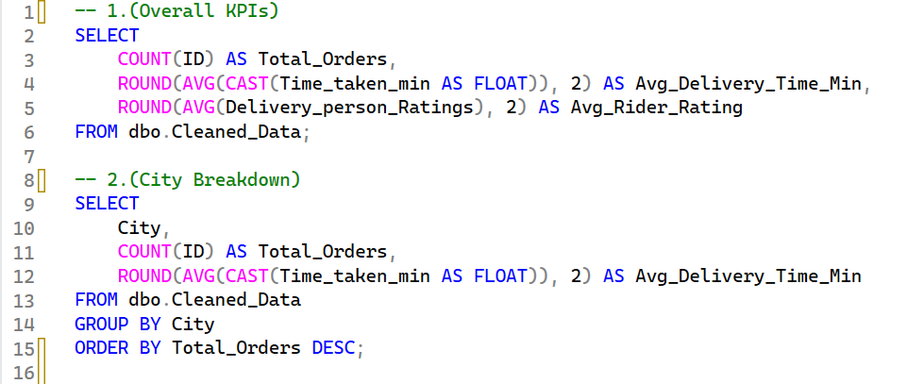
PART 2 · COMPANY-WIDE ANALYSIS
Overall KPIs & City Breakdown
Overall Efficiency & Geography
High order density in Metropolitan areas: the vast majority of deliveries are concentrated there, requiring localized hubs to maintain fast fulfillment.
Delivery time bottlenecks: average delivery times spike during severe traffic density and unfavorable weather, highlighting the need for dynamic route adjustments.

Slide 16
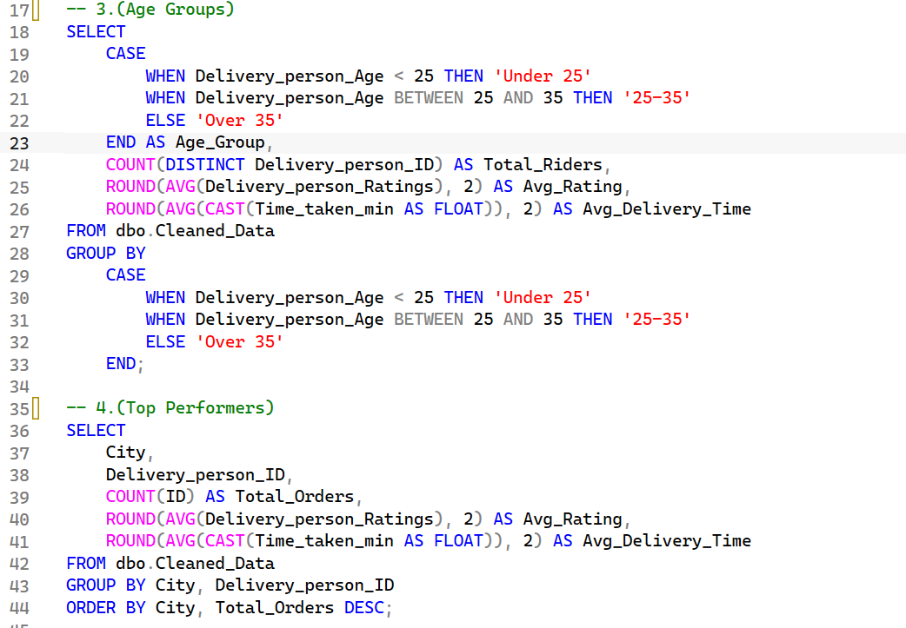
PART 2 · COMPANY-WIDE ANALYSIS
Age Groups & Top Performers
Rider Performance & Demographics
Age group dynamics: riders aged 25–35 handle the highest volume of orders while maintaining consistent rating performance.
Rating consistency: top-rated drivers consistently achieve lower average delivery times, showing a strong link between punctuality and customer satisfaction.

Slide 17
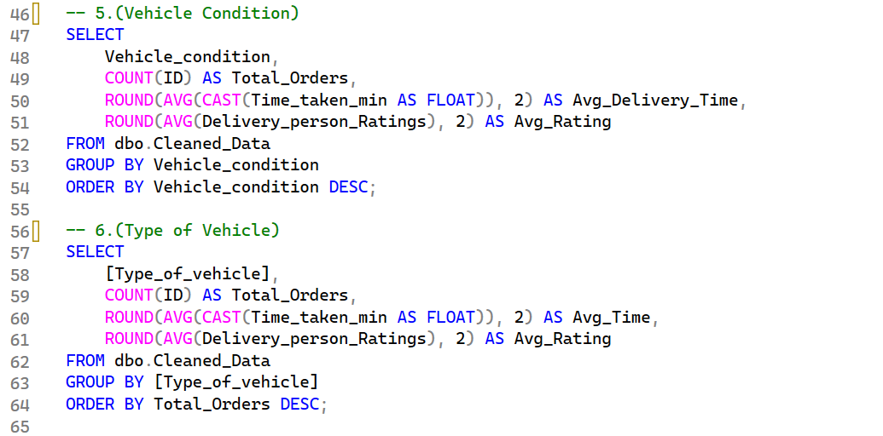
PART 2 · COMPANY-WIDE ANALYSIS
Vehicle Condition & Type
Fleet & Vehicle Utilization
Vehicle condition impact: vehicles in optimal condition (levels 2 & 3) reduce average delivery times compared to poorly maintained vehicles.
Vehicle type performance: electric scooters and motorcycles are more efficient in high-density traffic zones than standard bicycles.

Slide 18
PART 2 · COMPANY-WIDE ANALYSIS
Key Recommendations
1
Optimize Fleet Allocation
2
Preventive Vehicle Maintenance
Prioritize deploying motorcycles and electric scooters in heavy-traffic urban zones to reduce fulfillment delays.
Implement mandatory routine check-ups for company-provided fleets — better condition directly improves delivery speed.
3
Incentivize Top Riders
4
Dynamic Weather Routing
Create performance-based bonuses for riders maintaining ratings above 4.8 to improve retention and service quality.
Adjust estimated delivery times during adverse weather to manage customer expectations and prevent cancellations.

Slide 19
SECTION 03
Dashboard using Power BI
An interactive dashboard for exploring delivery performance at a glance

Slide 20
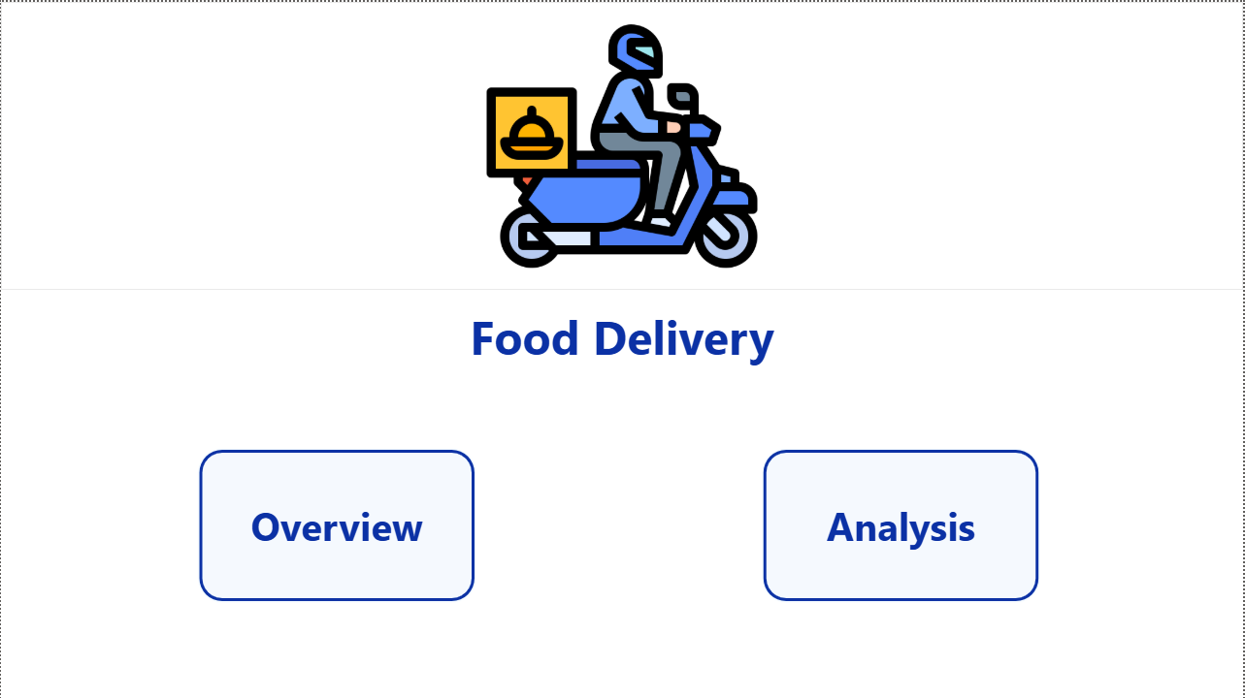
POWER BI DASHBOARD
Home
A simple landing page with navigation buttons to the Overview and Analysis pages.

Slide 21
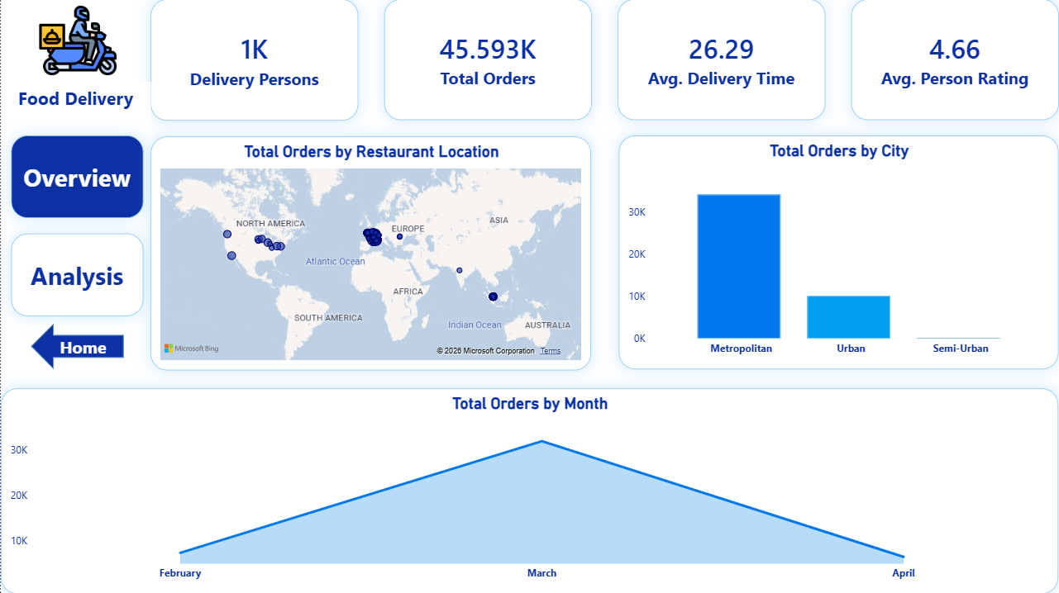
POWER BI DASHBOARD
Overview
Top-level KPIs — total orders, delivery persons, average delivery time and rating — alongside order volume by restaurant location, city, and month.

Slide 22
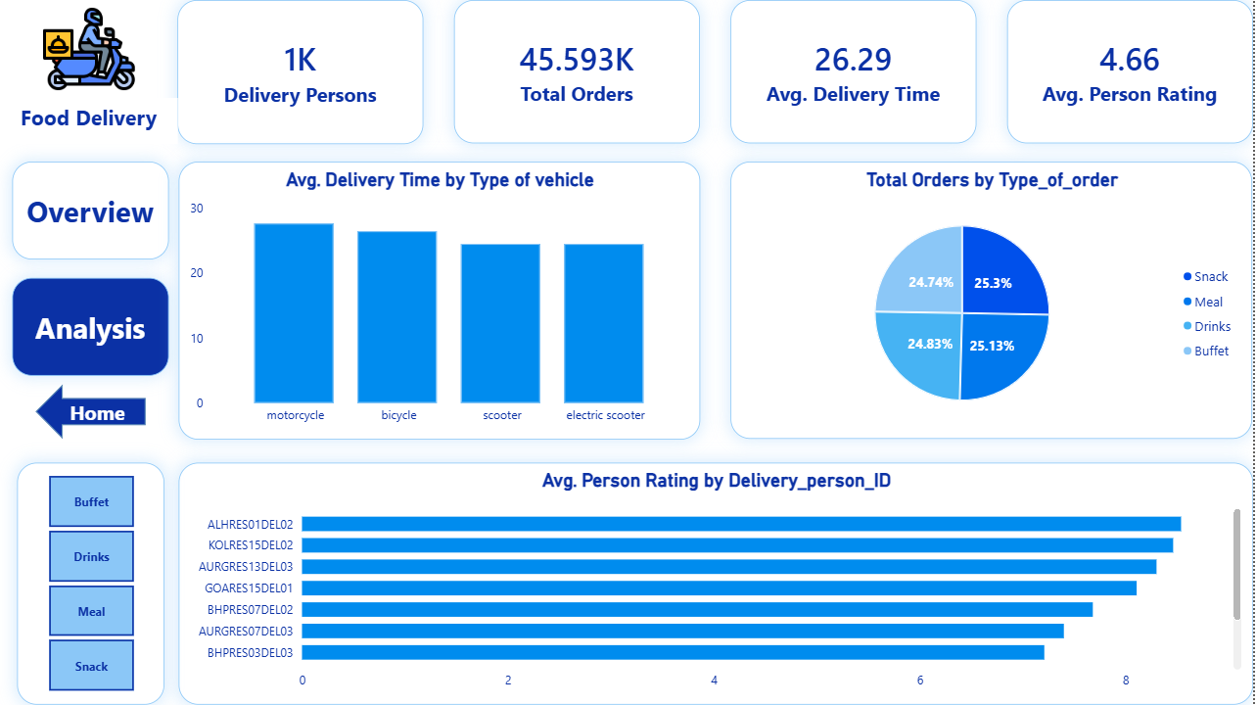
POWER BI DASHBOARD
Analysis
A deeper look at average delivery time by vehicle type, order-type distribution, and top-rated delivery persons.

Slide 23
SECTION 04
Dashboard using Excel
A self-contained operations dashboard built with PivotTables and slicers

Slide 24
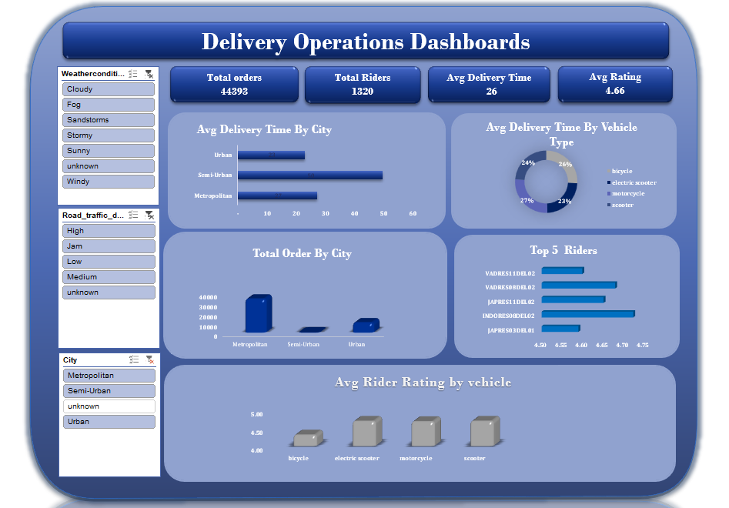
EXCEL DASHBOARD
Delivery Operations Dashboard
Filterable slicers for weather, traffic density, and city drive live views of total orders, average delivery time, average rating, and top-performing riders.

